Slide 1
Project Name :- E-commerce Customer Segmentation and Prediction
Presented By :- Saumyadeep Bardhan
Batch Name :- KPST-NOV2025-DSAI-1
Course Name :- Data Science & Artificial Intelligence
Program :- Master Diploma
P

Slide 2
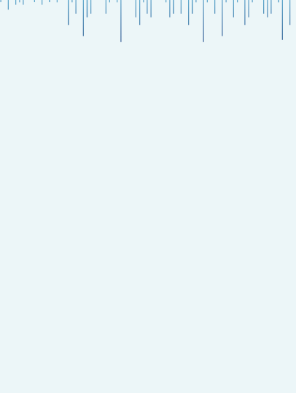
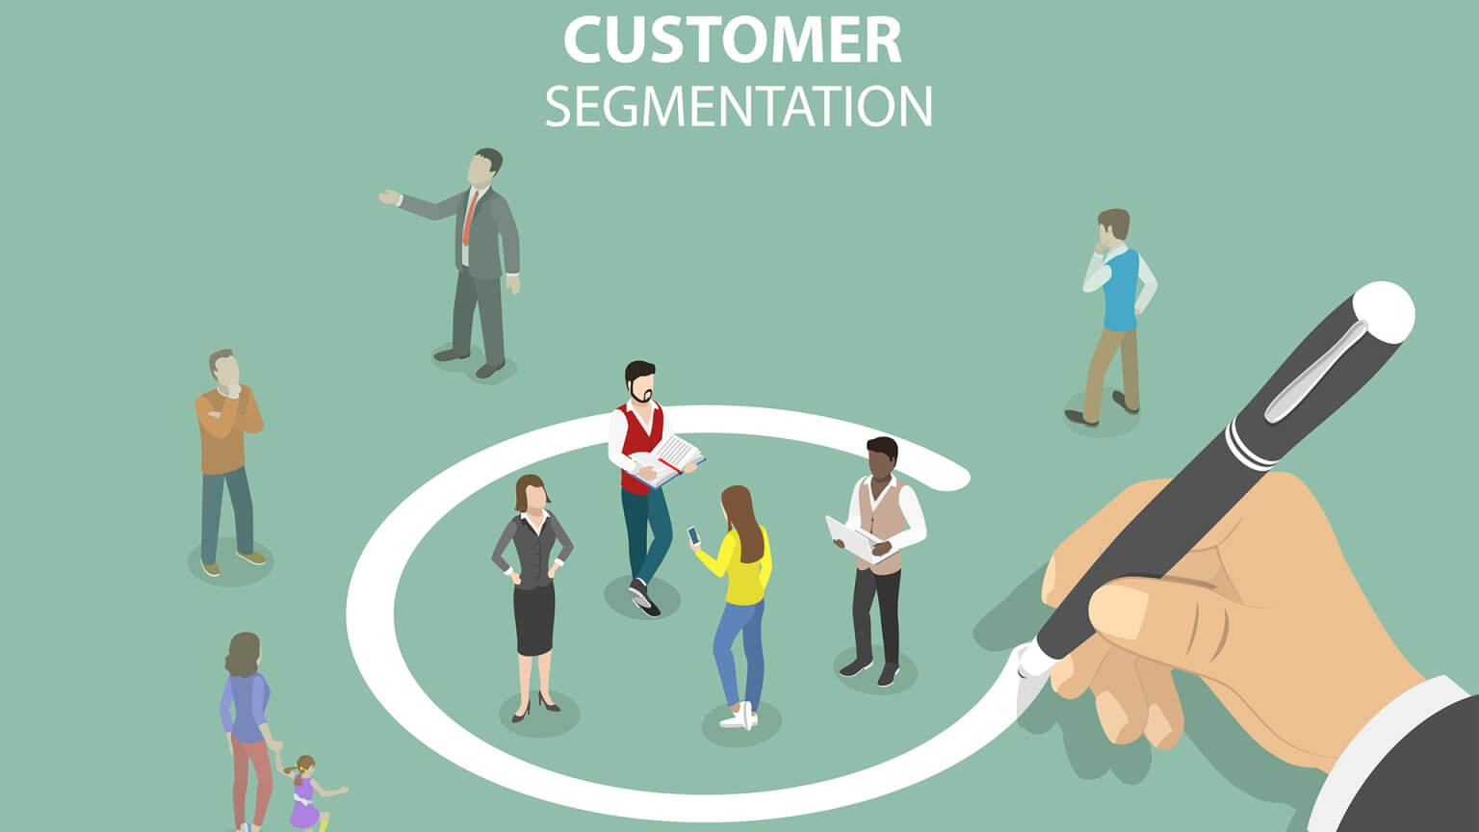

E-commerce Customer Segmentation and Prediction
“ In the e-commerce sector, this project applies machine learning techniques such as RFM analysis and clustering to segment customers and predict churn. By identifying critical behavioral insights, it supports improved customer engagement, higher retention and increased profitability through data-driven strategies.”
Presented By:- Saumyadeep Bardhan

Slide 3
Agenda
Feature Engineering
RFM Analysis
Clustering Analysis
Churn Prediction
Deployment
Conclusion
Actionable Recommendations
InIntroductiontroduction
Data Gathering and Reading
Data Preprocessing
Key Data Insights
Introduction
Data Gathering and Reading
Data Preprocessing
Key Data Insights

Slide 4
Introduction
Objective:
Leverage customer behaviour to create segments and forecast churn, enabling improved retention and increased profitability.
Key Questions:
Q. Who are the most valuable customers ?
Q. Which customers are at the risk of churn ?
Q. How can we improve customer engagement ?
Tools Used:
Python
Machine Learning
RFM Analysis

Slide 5


Churn Prediction
STEP
Predict which customers are likely to stop purchasing.
07
STEP
Clustering Analysis
06
Group customers with similar behavior using clustering techniques.
RFM Analysis
STEP
Segment customers based on RFM scores.
05
WORK FLOW
STEP
Feature Engineering
04
Create RFM metrics to quantify customer behavior.
Key Data Insights
STEP
03
Extract meaningful patterns and trends from the data.
STEP
Data Preprocessing
02
Analyzing and visualizing data patterns to clean and prepare data for analysis
Data Gathering & Reading
STEP
01
Describe data sources and fields.

Slide 6
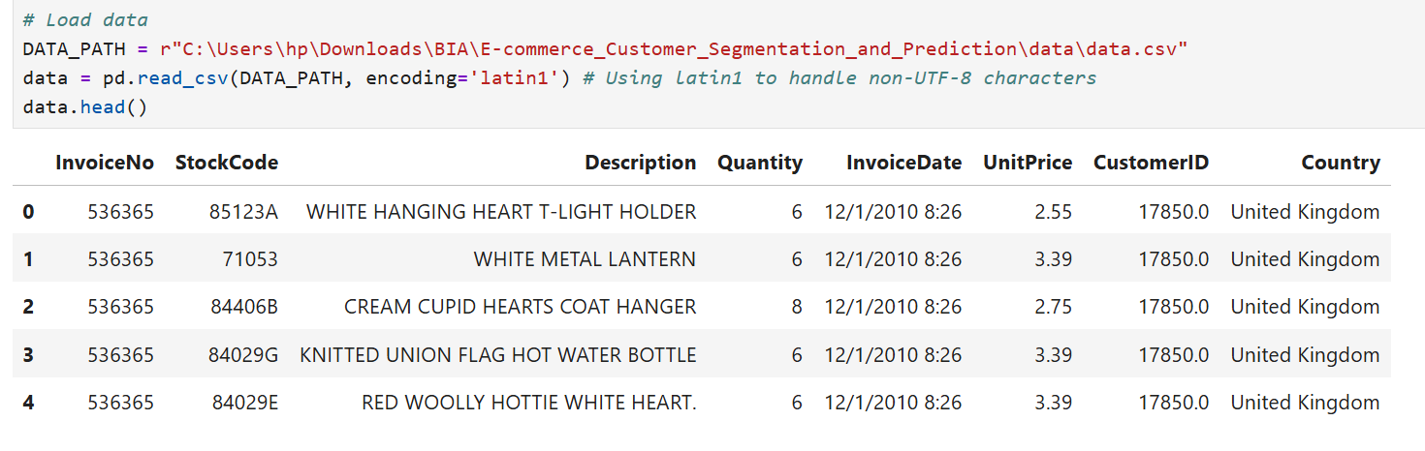
Data Fields
01: Data Gathering and Reading
Tools for Loading Data :
Python using Pandas for data loading and preprocessing
NumPy for numerical operations
Invoice Number
Stock Code
Product Description
Quantity
Invoice Date
Unit Price
Customer ID
Country

Slide 7
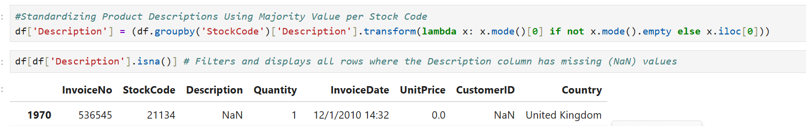
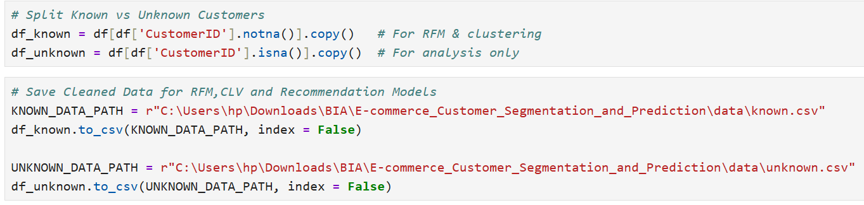
Outcome: Clean, structured data ready for analysis
02: Data Preprocessing
Missing value identification in Customer Id and Product Description columns
Handled missing values using most frequent value per Stock Code and remaining as “Unknown” in Product Description column
Checked for duplicate transactions and removed exact duplicate rows
Converted Invoice Date to datetime format, created Total Price column, Return flag to identify returned transactions
Splitting dataset into known customers and unknown customers on the basis of Customer ID

Slide 8
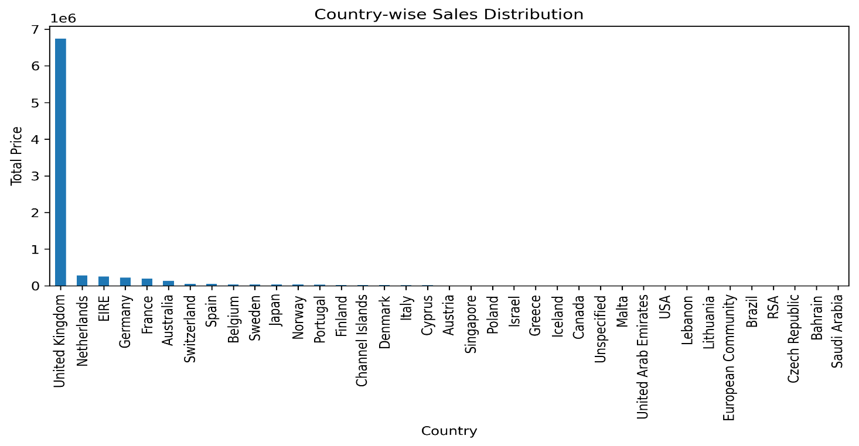
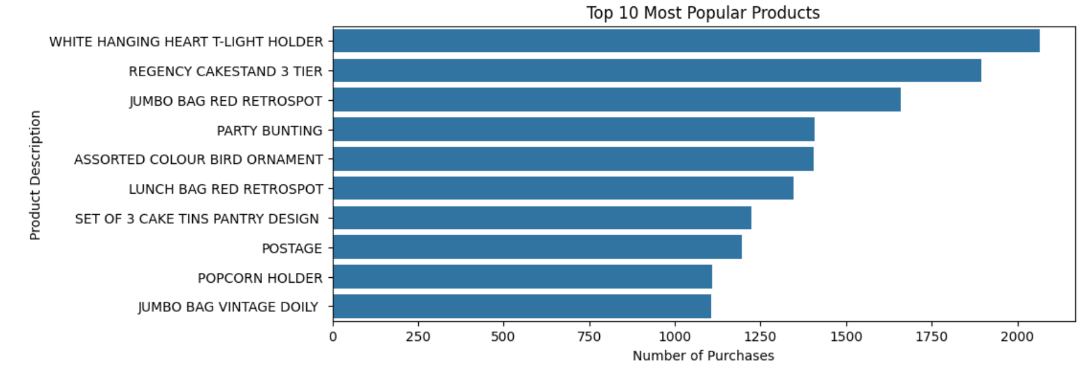
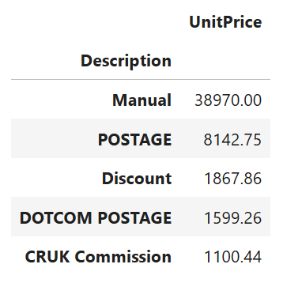
Uncovering Hidden Insights from Data
03: Key Data Insights
Most Active Countries (Bar Chart)
High-Priced Products (Table)
Top Revenue-Generating Products (Bar Chart)

Slide 9
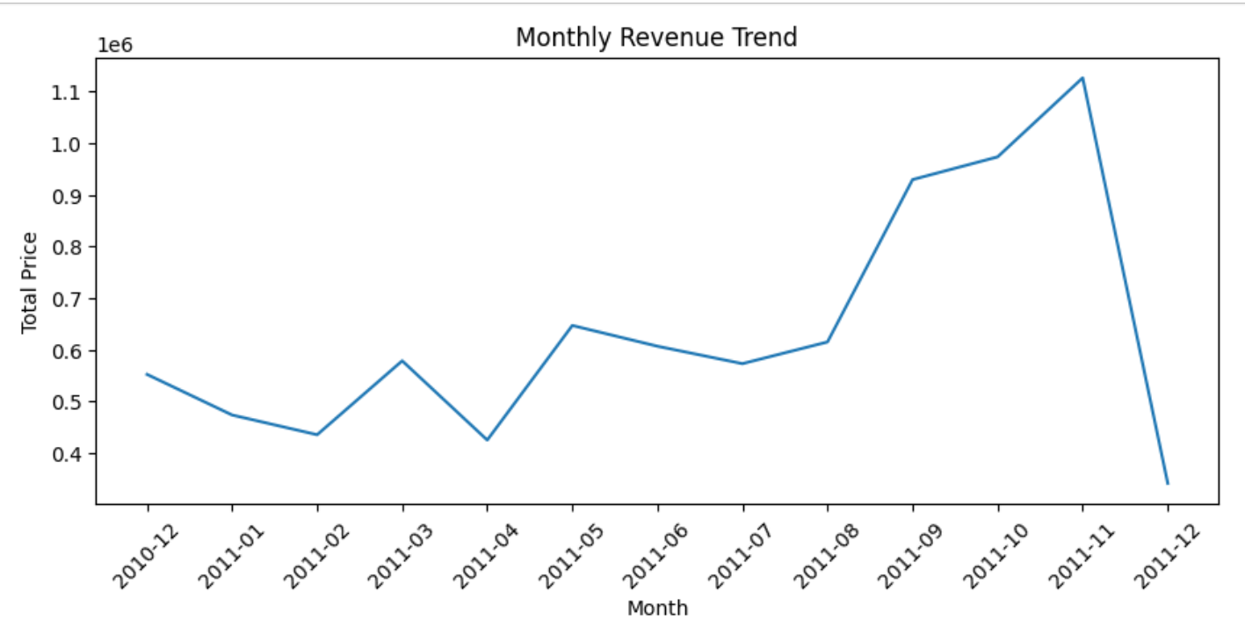
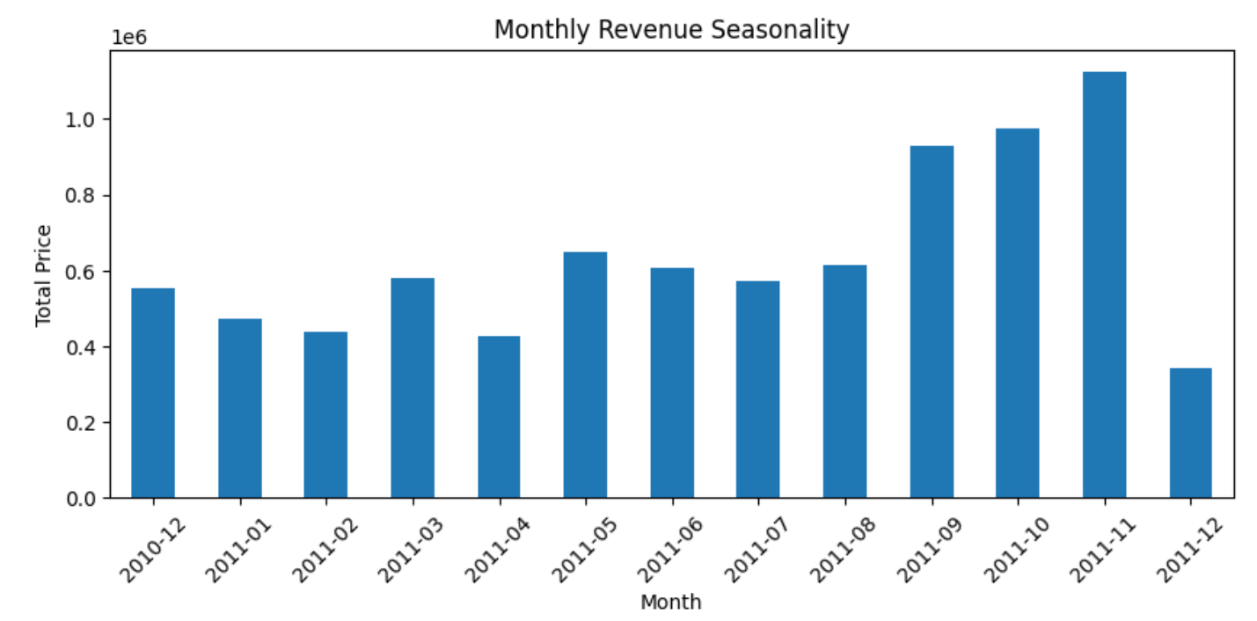
Uncovering Hidden Insights from Data
03: Key Data Insights (contd.)
Revenue Trends Over Time (Line Chart)
Monthly Revenue Distribution (Bar Chart)

Slide 10
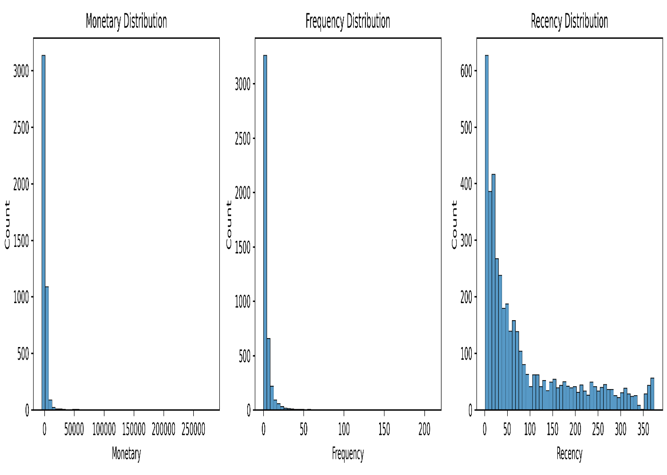
Purpose: Quantify customer for segmentation
04 : Feature Engineering
Recency -- Days since last purchase
Frequency – Number of times a customer makes purchases
Monetary – Total amount of money a customer has spent
Return Count – Number of returned transactions
Return Ratio – How much a customer returns compared to how much they purchase

Slide 11
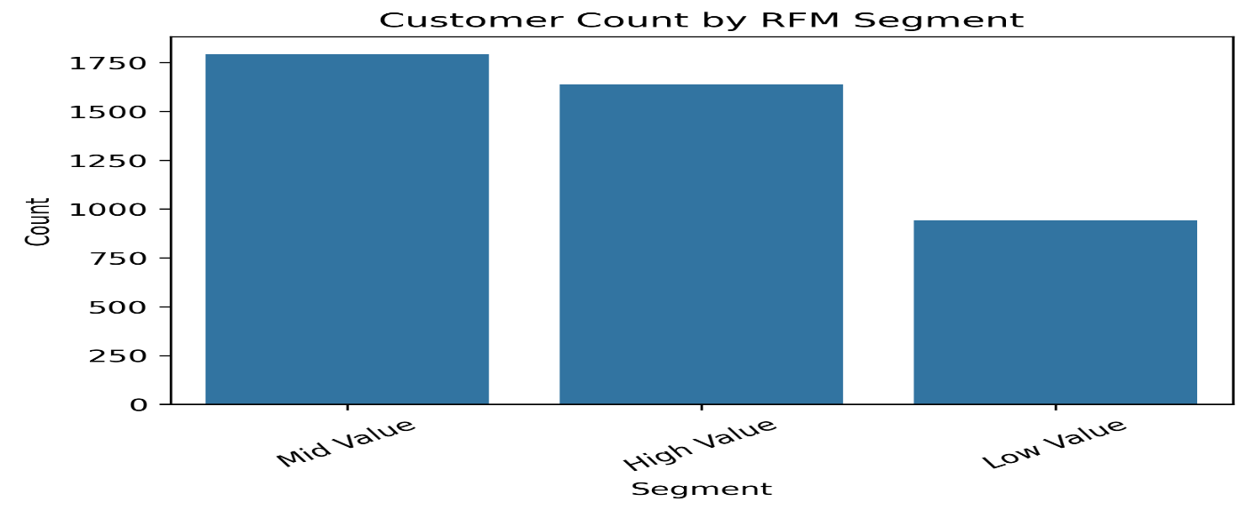
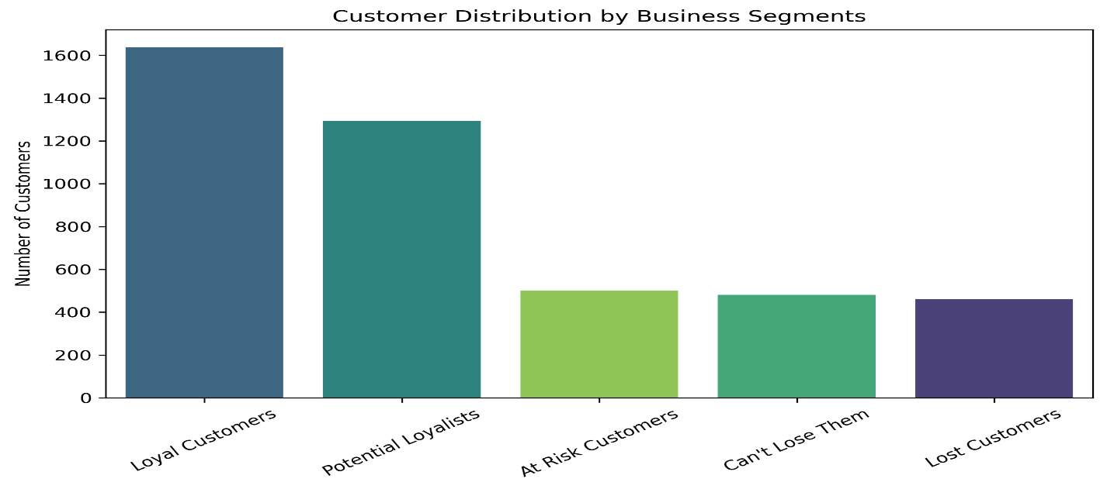
Customer Segments :
05 : RFM Analysis
Loyal Customers -- Frequent, high-value customers who are actively engaged and should be retained through rewards and exclusive offers.
Potential Loyalists – Recently active customers with growing engagement who can be converted into loyal customers through personalized incentives.
At Risk Customers – Previously valuable customers who are becoming inactive and require targeted re-engagement strategies.
Can’t Loose Them – High-value customers showing signs of churn who need urgent retention efforts and personalized attention.
Lost Customers – Inactive customers with low engagement who can be targeted with win-back campaigns or deprioritized based on value

Slide 12
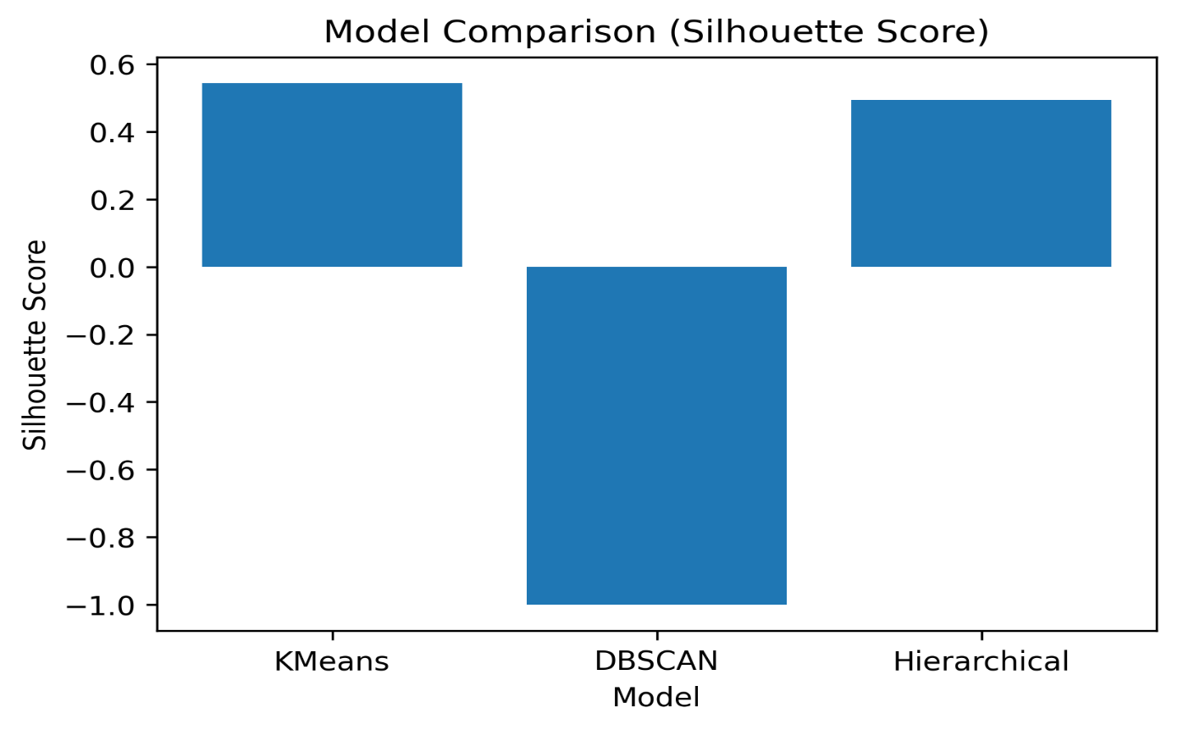
Clusters Identified
06 : Clustering Analysis
Cluster Driven Customer Segmentation (Business Focused)
High Return Customers – Customers with high return ratio, impacting profitability
Churn Risk Customers – Customers with high recency (inactive for long)
Champions – Customers with high frequency and high spending
Loyal Customers – Customers with high purchase frequency
Promising Customers – Customers who are recently active but not frequent buyers yet
Occasional Customers – Customers with low engagement across all metrics
Techniques Used :
K-Means
DBSCAN
Hierarchical Clustering

Slide 13
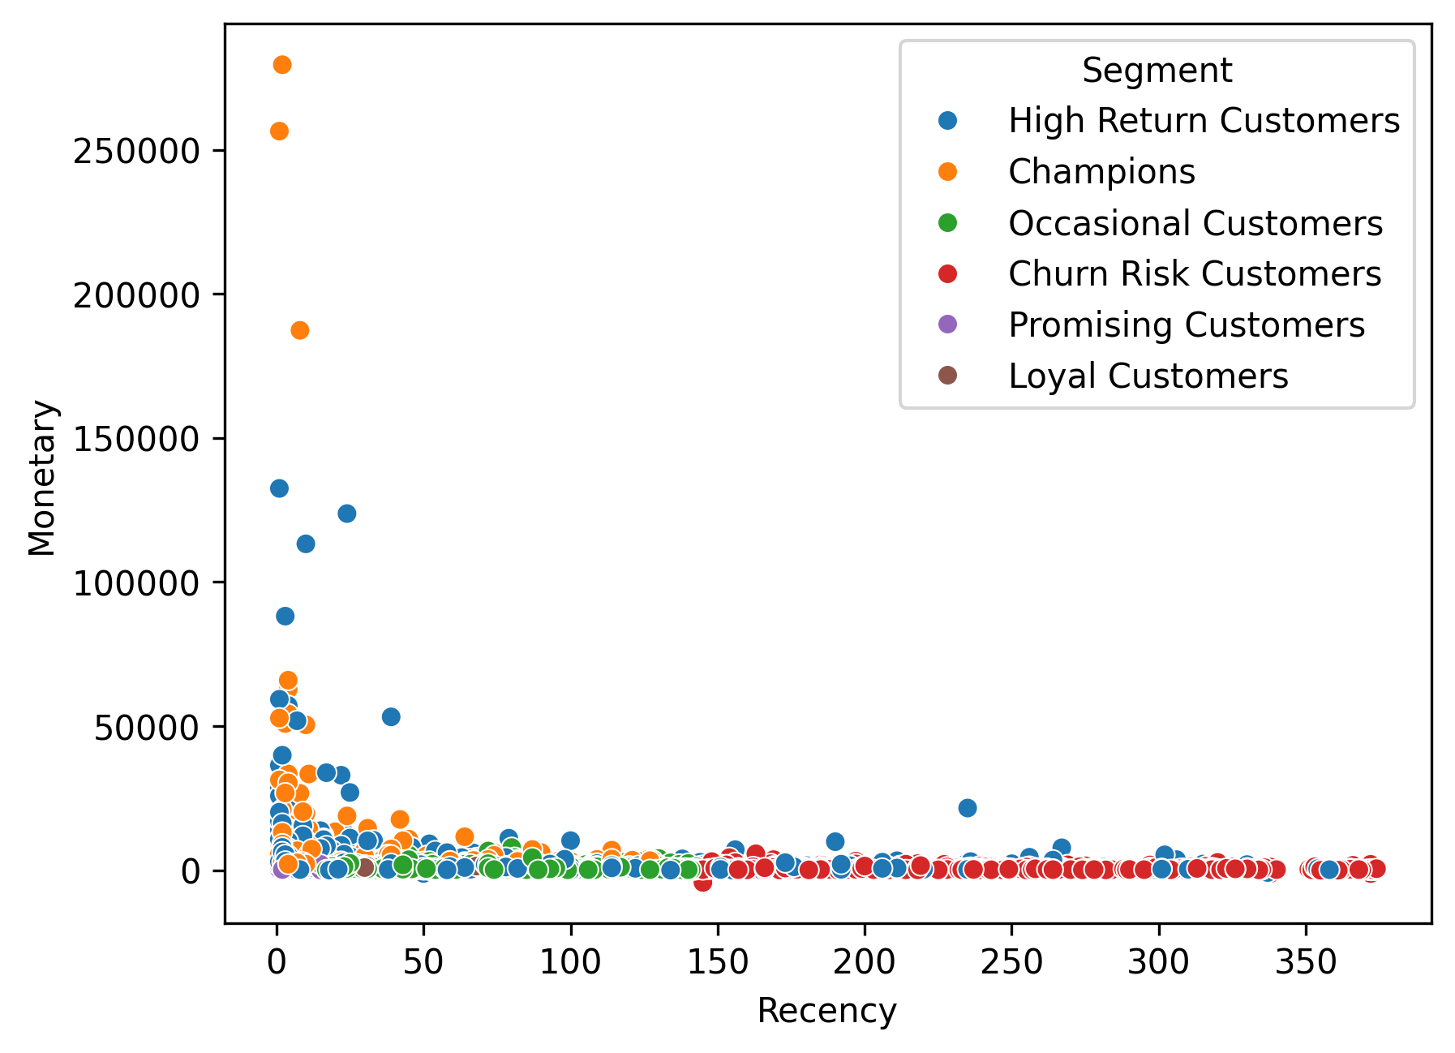
Cluster Analysis
06 : Clustering Analysis (Contd.)
Actionable Insights :
High Return Customers – Minimize returns through improved product quality, clearer descriptions and stricter return policies
Churn Risk Customers – Re-engage with targeted campaigns, personalized offers and timely reminders
Champions – Retain and reward with exclusive benefits, loyalty programs and early access to offers
Loyal Customers – Increase value through upselling, cross-selling and personalized recommendations
Promising Customers – Nurture engagement with tailored offers to convert them into loyal customers
Occasional Customers – Drive repeat purchases using discounts, promotions and targeted marketing campaigns.

Slide 14
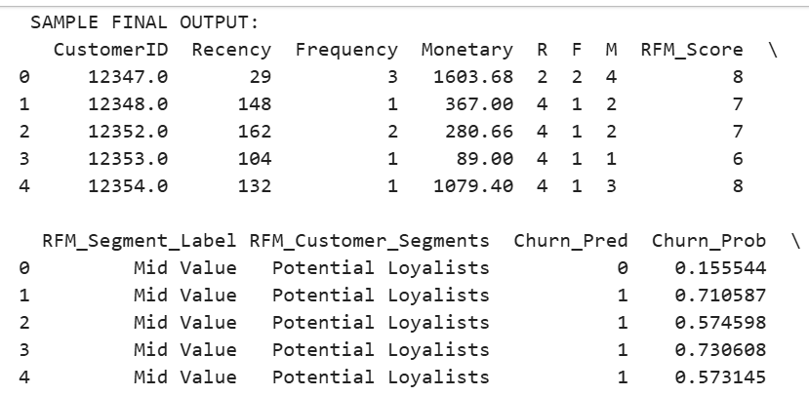
Actionable Insights
07 : Churn Prediction
Identify high-risk customers early and apply targeted retention strategies to reduce churn
Leverage behavioral insights to personalize engagement and maximize customer lifetime value
Models Used :
Logistic Regression
Random Forest
AdaBoost
XGBoost
SVC
Features:
RFM Metrics, Customer Value Indicators, Behavioural Patterns, Recent Activity, Purchase Trends for capturing both long-term loyalty and short-term engagement.
Output :
The model generates a churn probability score for each customer, enabling classification into high, medium and low risk segments for targeted retention strategies.

Slide 15
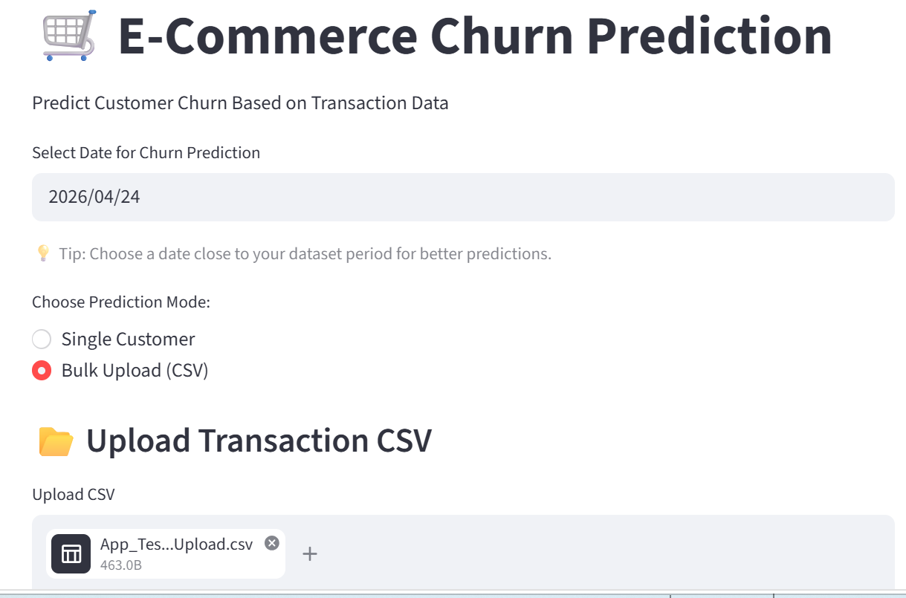
Churn Prediction System Deployment
Deployment
Deployed the churn prediction model as an interactive web application using Streamlit, making it easily accessible to non-technical users.
Designed a clean and intuitive interface supporting both single-customer input and bulk CSV uploads for a flexible usage.
Integrated real-time prediction capabilities to generate churn probability scores instantly.
Translated model outputs into clear risk segments (High, Medium, Low) along with recommended action for each segment to support business decision making.
Enabled result visualization and CSV download functionality allowing teams to act on insights.

Slide 16
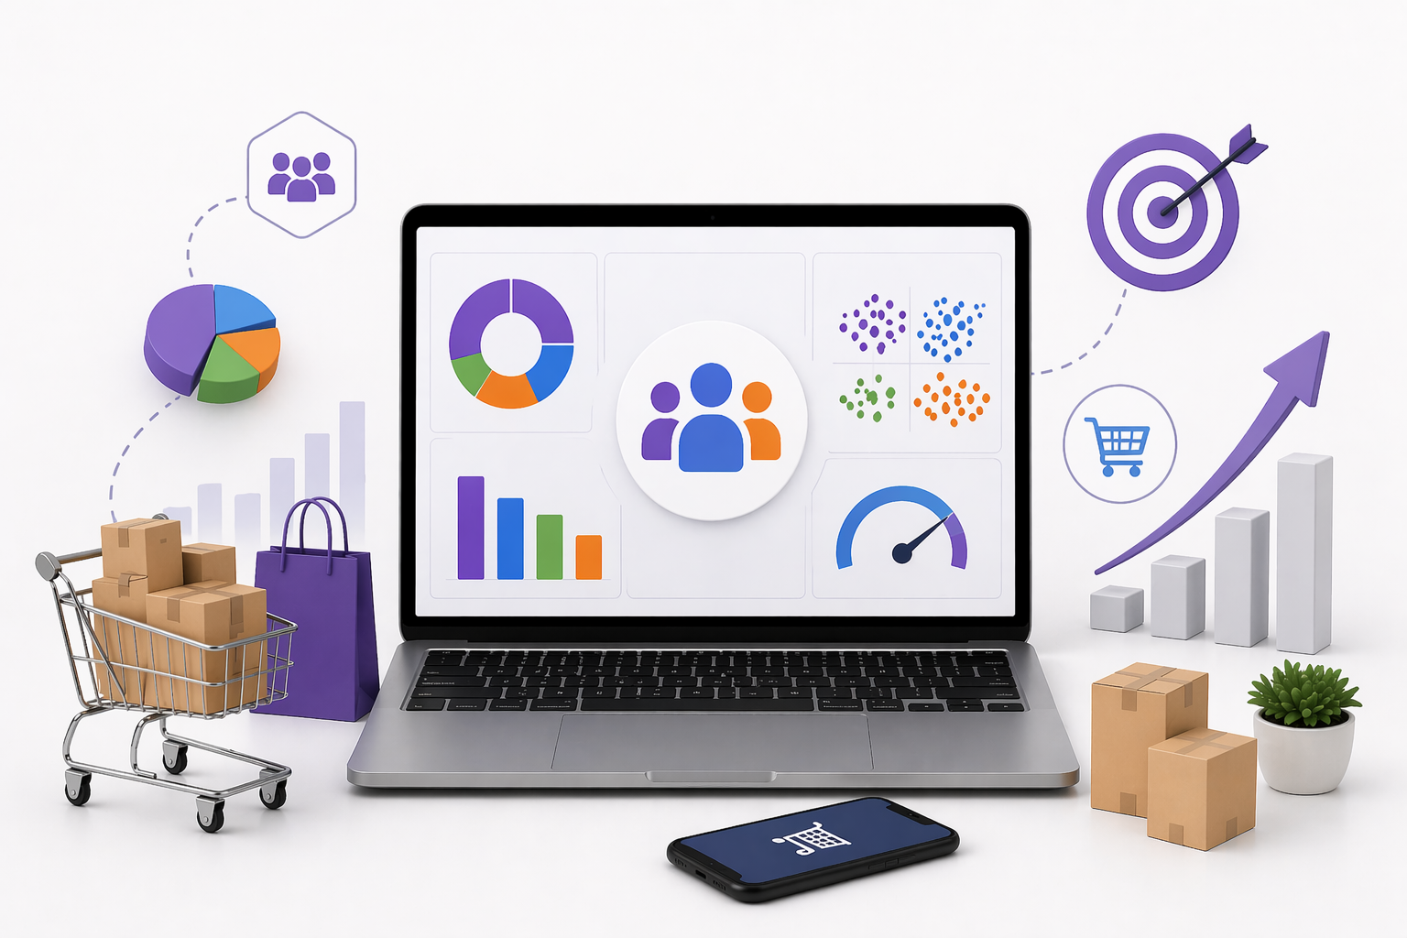
Key Takeaways
Conclusion
Designed and implemented an end-to-end pipeline encompassing data preprocessing, model development, evaluation and prediction.
Leveraged RFM analysis and clustering techniques to derive actionable customer segments and behavioral insights.
Developed a robust churn prediction model using advanced feature engineering to capture customer value, engagement and temporal patterns.
Deployed the solution as an interactive Streamlit application, enabling real-time predictions and seamless business usability.
Transformed model outputs into risk-based insights with tailored recommendations to support proactive customer retention strategies.

Slide 17
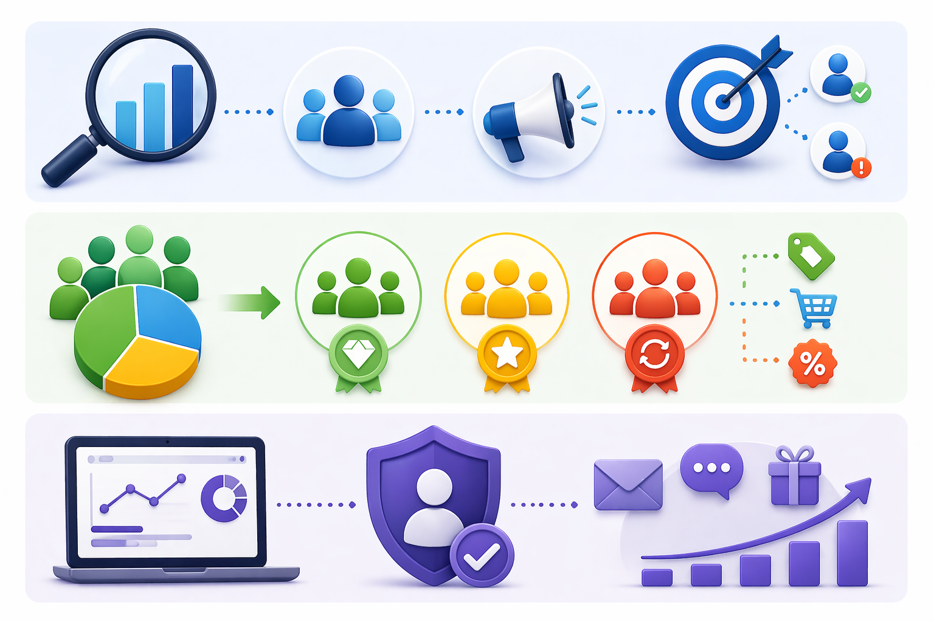
From RFM Analysis :
Retain high-value customers through loyalty programs and personalized rewards , while re-engaging at-risk customers with targeted behaviour-driven campaigns.
Actionable Recommendations
From Clustering :
Focus on high-value clusters with premium offerings, nurture medium-value customers through personalized engagement and cross-selling and revive low-engagement segments using targeted incentives and reactivation strategies.
From Churn Prediction :
Proactively identify at-risk customers and implement timely, personalized retention strategies such as targeted discounts, engagement reminders and tailored outreach to reduce churn and strengthen customer relationships.

Slide 18
Questions ?

Slide 19
Thank You!

